Slide 1

Project Title : Smart Elevator
Course No : EEE-4232
Course Title : VLSI-II Lab
Section : A1B1C2
Presented By
Group : 05
Student ID’s : 190205083,190205182,190205184,190205186(L)

Slide 2
Key Features :
Our Verilog code implements a control system for a smart elevator. Various commands are allocated for different elevator modes using an up-down movement. This system ensures that the elevator spends the appropriate amount of time on each floor (e.g., opening doors, closing doors, moving between floors). The Verilog code interfaces with various hardware components, including floor sensors, light sensor, weight alert, emergency-stop, building alarm, peak hour, power supply and power generator.
SOC design integration:
As part of this project, We’ve worked on the System-on-Chip (SOC) design layer, leveraging tools like Genus and Innovus.

Slide 3
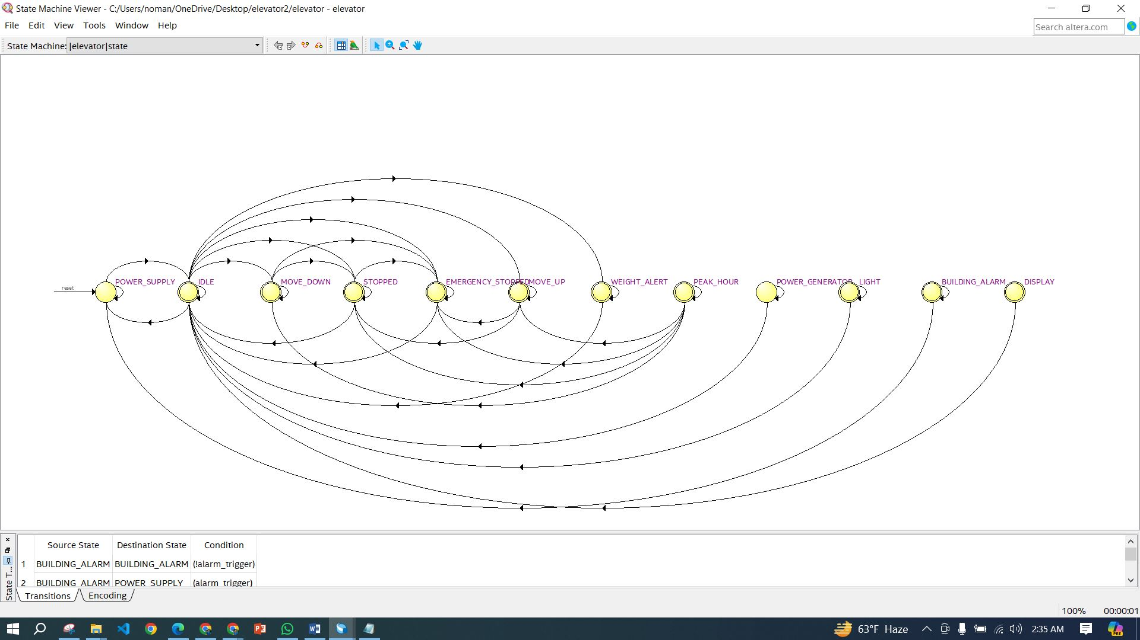
Finite State Machine

Slide 4
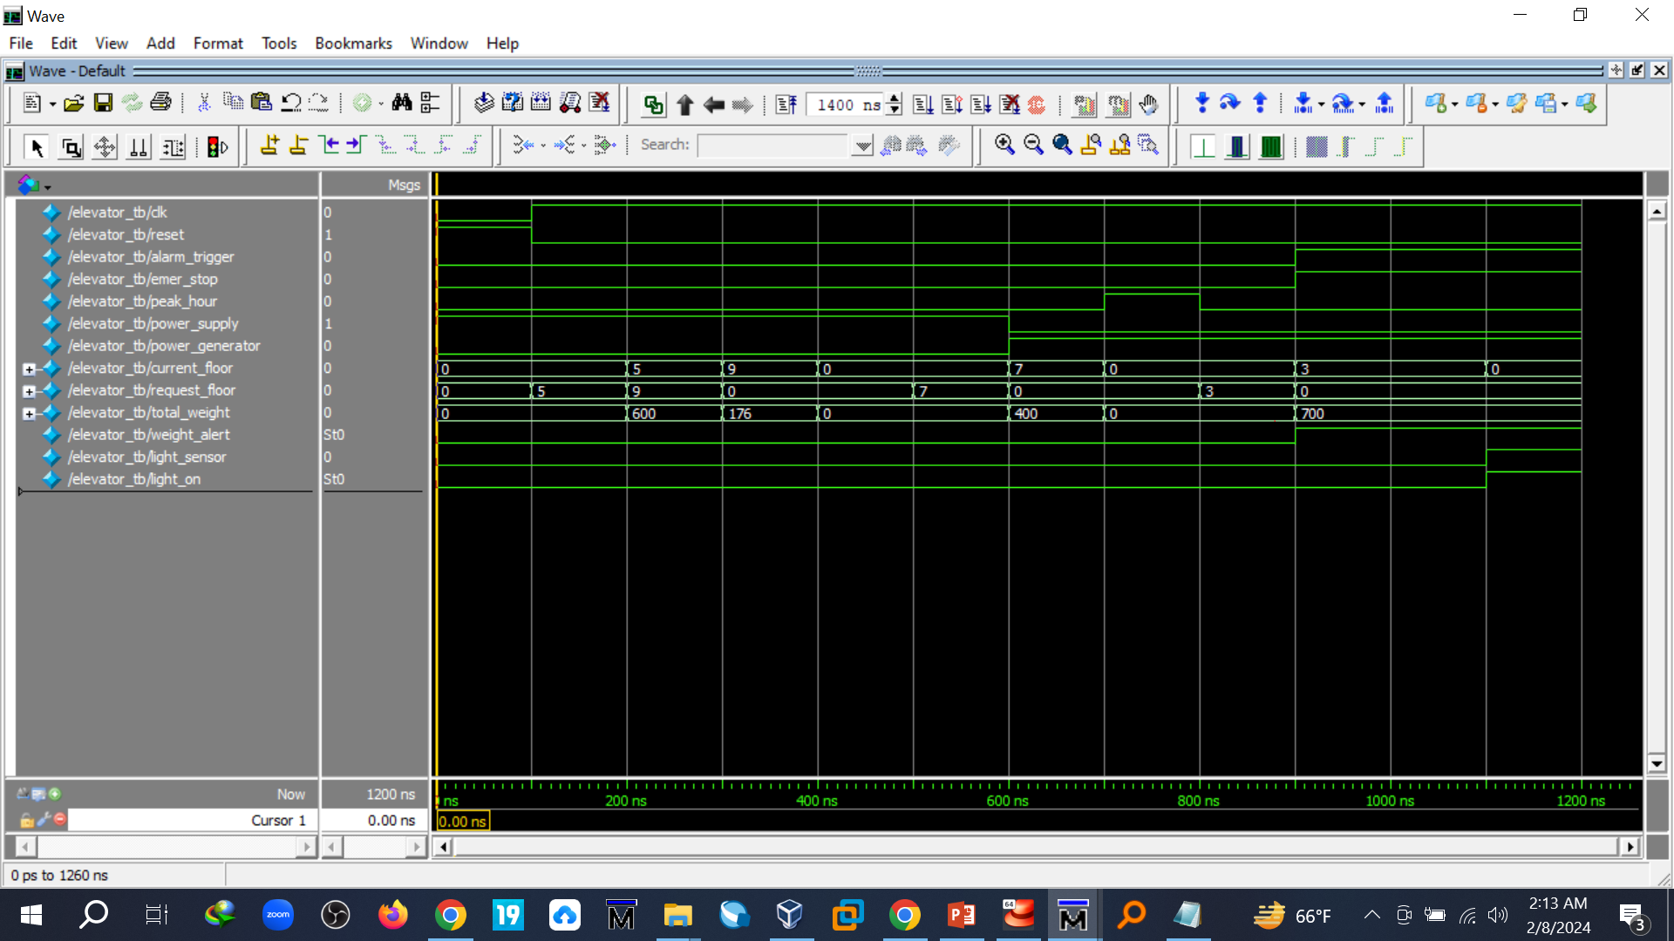
Test Bench

Slide 5
The first step in the Cadence Design Place and Route (PnR) process is to use Modelsim and Quartus to create a hardware description in Verilog code. Next, synthesis is performed using a clock frequency of MHz to create a gate-level netlist using a scripted command called synthesis_script.tcl. After switching from Genus to Innovus, the Design Import interface sets up important parameters including restrictions, RC corners, delay corners, and library sets. The first chip cell location is then determined by the floorplan, and power distribution networks are developed for power integrity. In order to create a functioning integrated circuit design that complies with design restrictions and meets performance, power, and space requirements, this all-inclusive methodology harmonizes circuit design, synthesis, and layout.
The table below displays the synthesis parameters used for this project's particular operation:
Parameter | Initial Clock Frequency | Maximum Transition (ns) | Driving Cell | Input Delay | Output Delay | Maximum Fanout
 | 180 | 0.4 | BUFX2 | 3.08 | 2.56 | 7

Slide 6
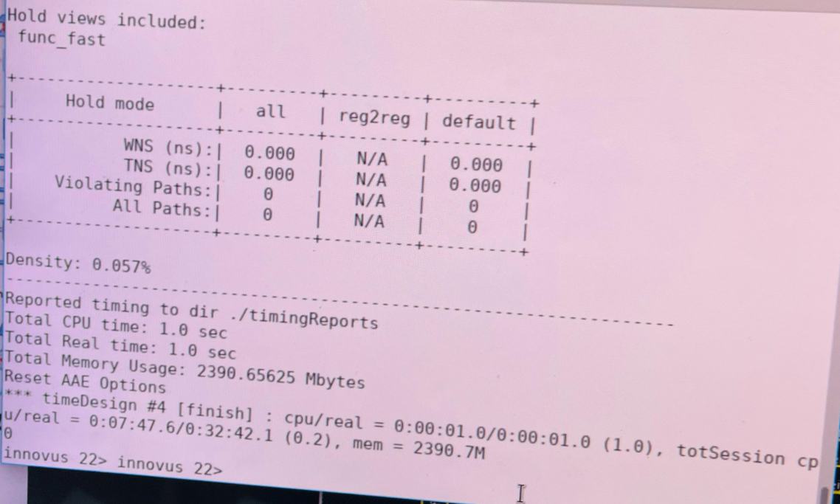
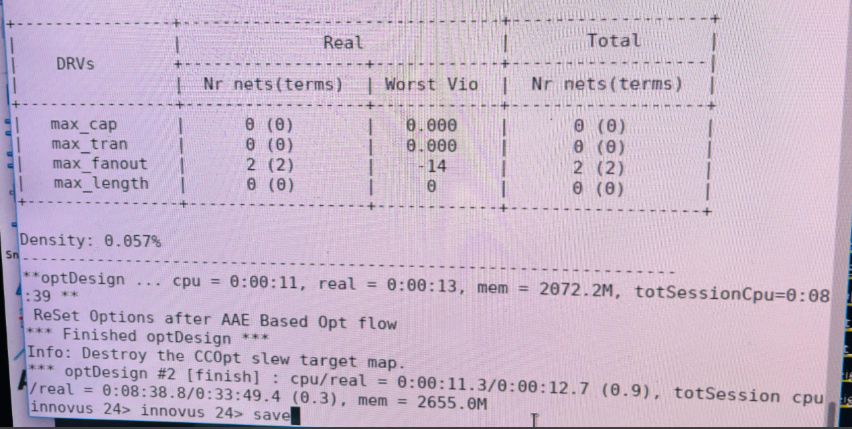
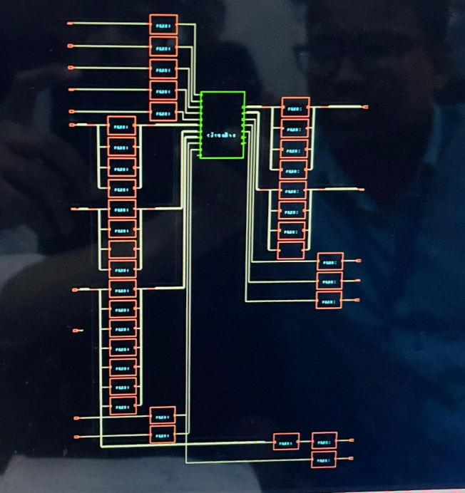
Time design analysis
Time Design Summary
OptimizedTime Design Summary
GUI Show

Slide 7
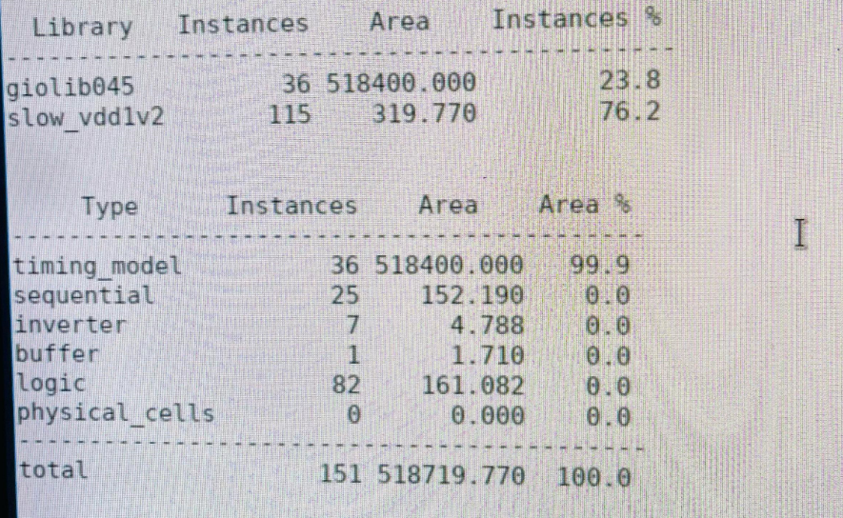
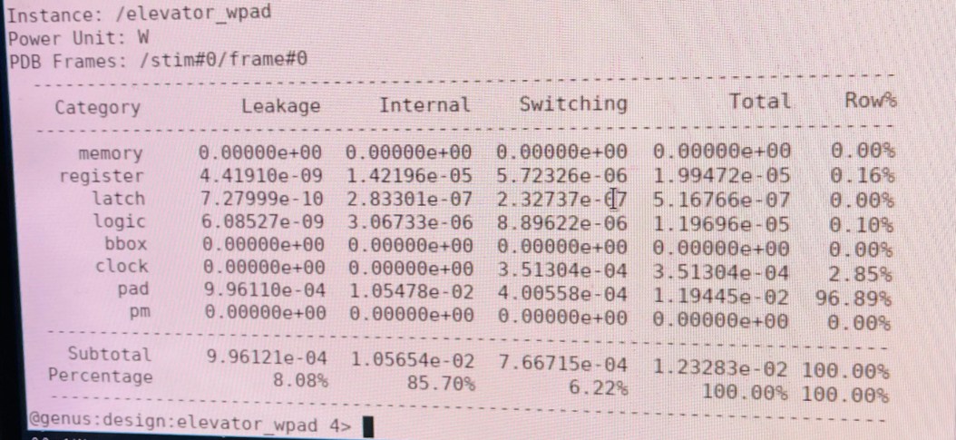
Gatecount & power information
Total Gate Count
Total Power Information

Slide 8
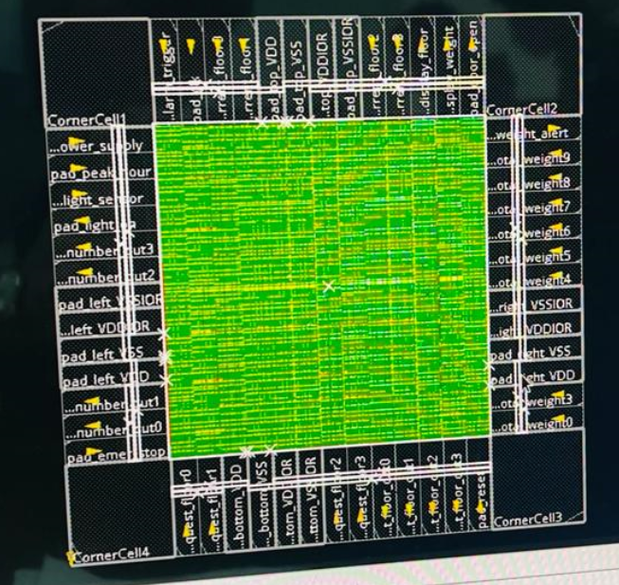
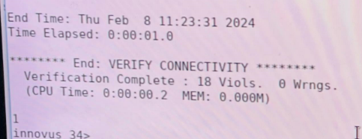
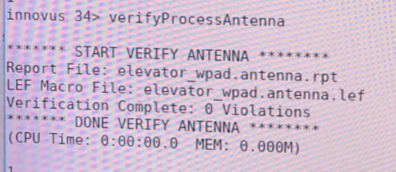
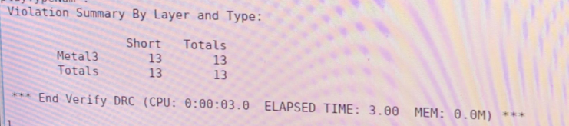
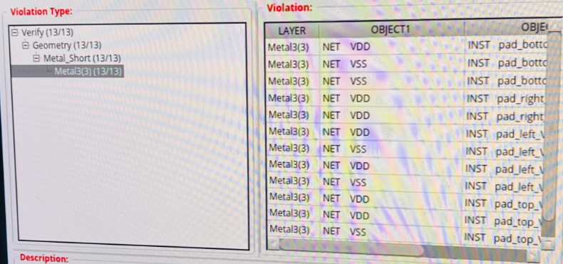
Total violation and final design
Total Violation
DRC Violations : 13
Geometric Connectivity:18
ARC Violations : 0
Final Design
Connectivity Violation Verification
ARC Violation
Verification
DRC Violation
Verification

Slide 9
Thank You

